Slide 1
DATA PIPELINE PROJECT
March 13th, 2025

Slide 2


Objective
Develop data pipeline based on Lambda Architecture for Stock Data.
1
Source Data
AGENDA
2
Lambda Architecture
3
Batch Layer
4
Streaming Layer

Slide 3
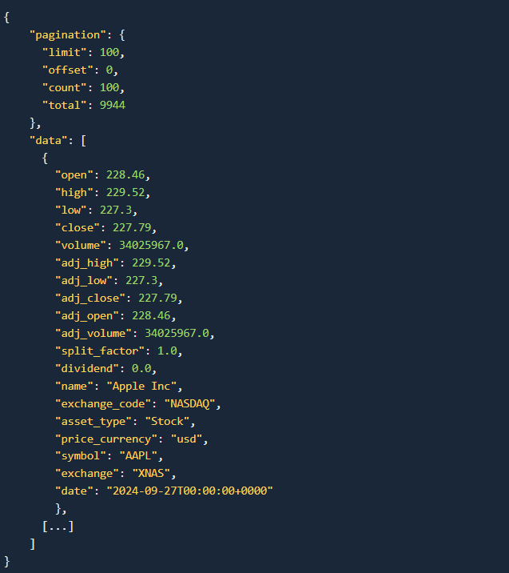
Source Data
REST API interface delivering worldwide stock market data in JSON format
End of Day, Currencies, Dividends, Splits, Tickers Information, Tickers List

Slide 4
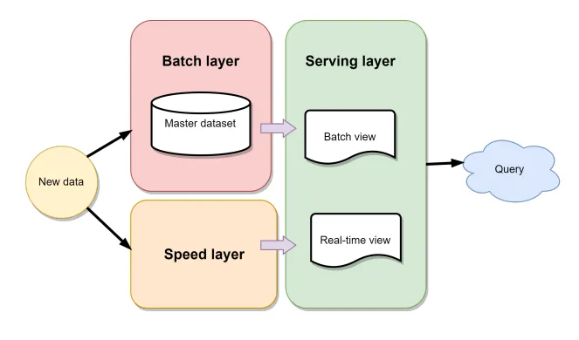
Lambda Architecture
Combining real-time and batch processing
3 data processing layers: Batch Layer, Speed Layer, and Serving Layer

Slide 5
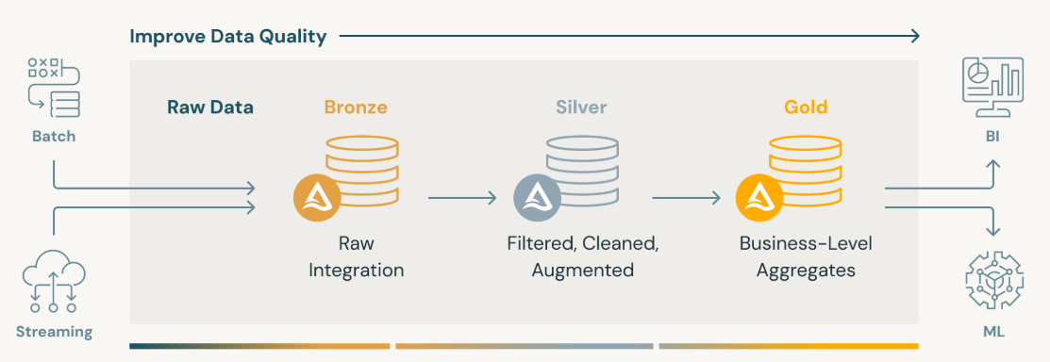
Medallion Architecture
Data design used to logically organize data in a lake house
Improve the structure and quality of data through each layer of the architecture

Slide 6
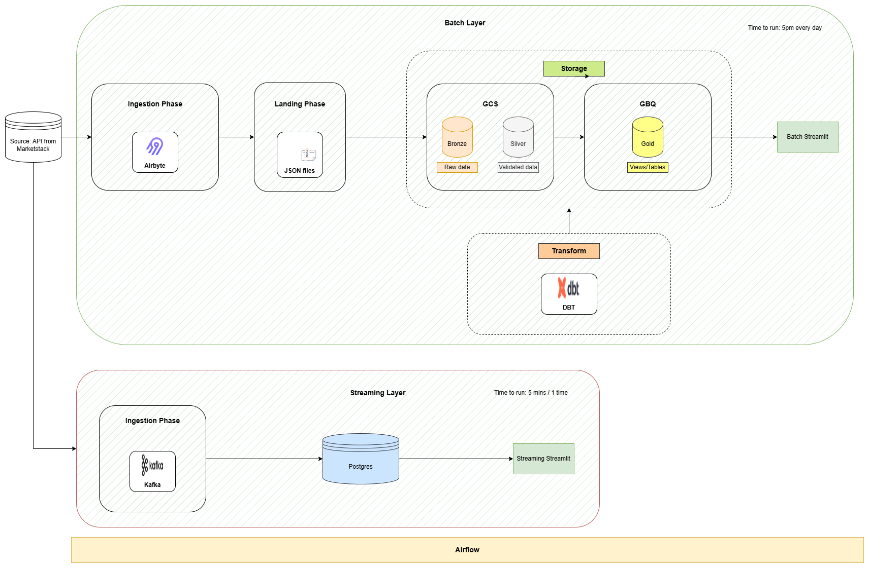
Lambda Architecture

Slide 7
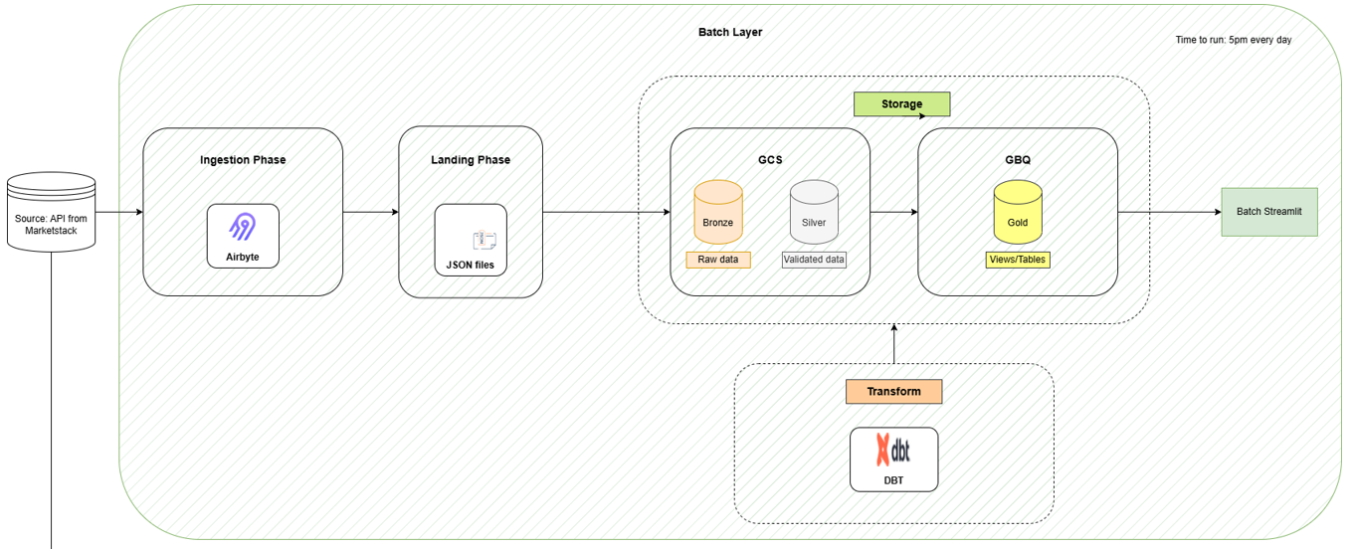
Batch Layer
Schedule to run 5PM every day
Get raw API data (json files) with Airbyte and save it in GCS.
Use Airflow to convert json data to dataframe format, save this dataframe in GCS with delta table format
Use Airflow to get delta data from Bronze Layer, validate data such as data type, missing value… and save validated data in GCS with delta table format
Use DBT to build available data (example: Top 10 stocks with the highest price increase compared to yesterday)

Slide 8
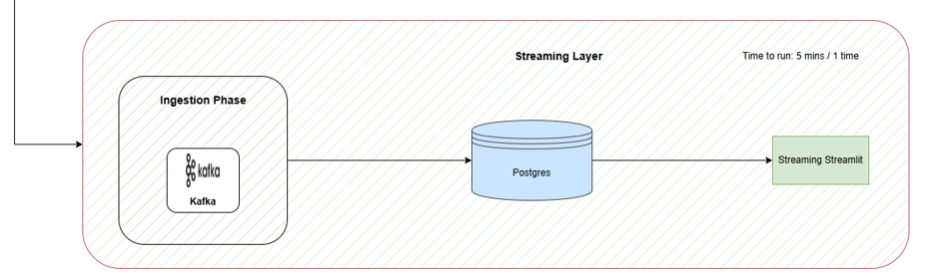
Streaming Layer
Schedule to run every 5 minutes
Use Kafka to get raw API data (json files) into Kafka Topic
Use Airflow as Consumer to get data and push data into Postgres tables

